Slide 1
Practice based coaching model
Karen Cortez
Yesenia de la rosa
Sara corona

Slide 2
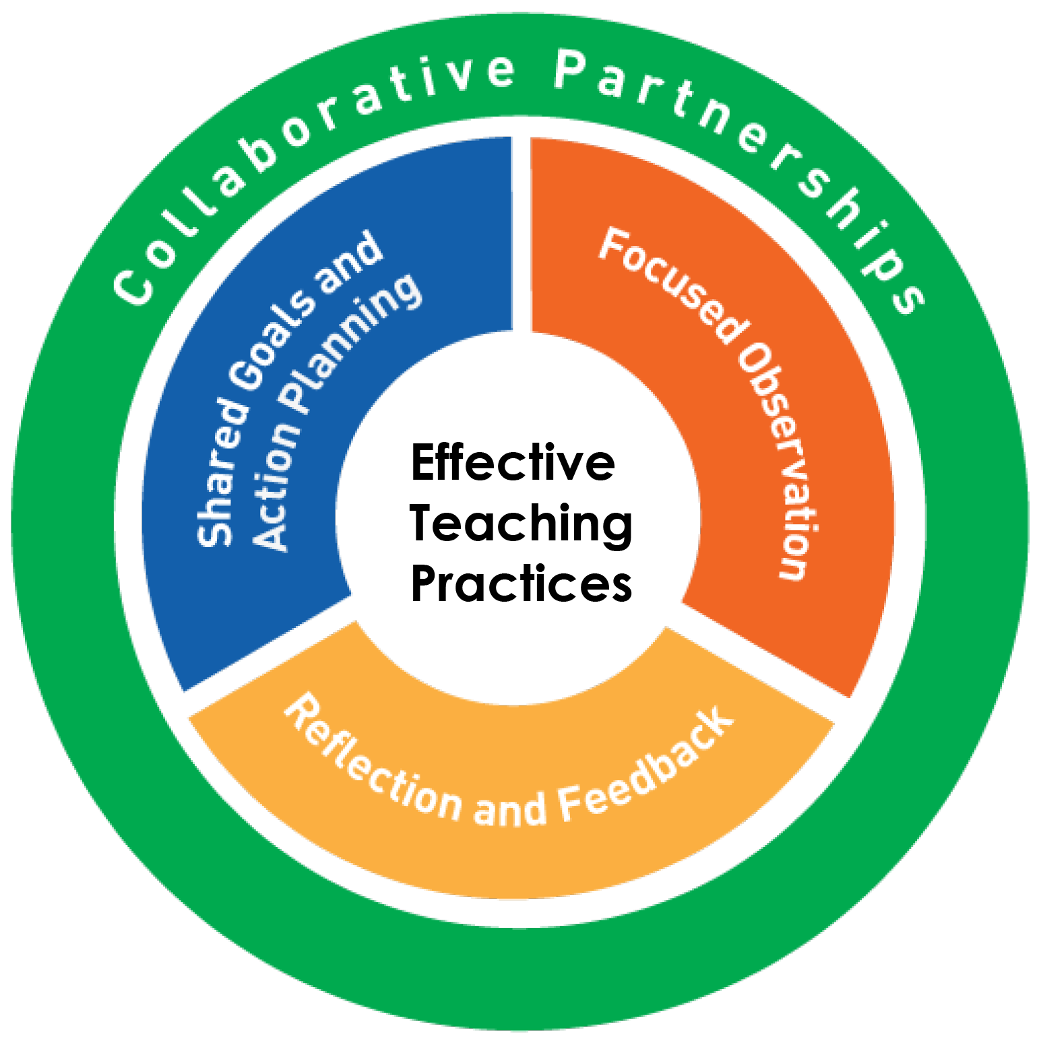
WHAT IS PRACTICE-BASED COACHING?
PBC is a cyclical process for supporting the use of effective practices that lead to positive outcomes for children and families.
The coaching cycle components are:
Planning goals and action steps
Engaging in focused observation
Reflecting on and sharing feedback about teaching and home visiting practices.
PBC occurs within the context of a collaborative partnership. Each component in the cycle is designed to inform the actions taken by a coach or coachee during the subsequent component (or throughout the coaching process). The cyclical nature of PBC emphasizes that expectations and desired outcomes of coaching are regularly reviewed and updated.
Notes:
The figure shows the PBC cycle and illustrates the relationships among the components.
Coach and coachee work together during the process
Coaching is collaborative in that the coachee and coach plan and execute it together
The goal is to provide support to the coachee as he or she attempts to try new things.

Slide 3
PRACTICE-BASED COACHING COMPONENTS AT-A-GLANCE
COMPONENT 1: SHARED GOALS AND ACTION PLANNING
COMPONENT 2: FOCUSED OBSERVATIONS
COMPONENT 3: REFLECTING ON AND SHARING FEEDBACK ABOUT TEACHING PRACTICES
Assess needs.
Set goals for coaching.
Create an action plan to guide coaching.
Review and update goals and action plan throughout coaching partnership.
Gather information through observation.
Record information about the observation.
Use support strategies to learn more about the practice or to improve or refine effective practices (coach models or prompts).
Discuss and reflect on observation and progress.
Share and consider feedback.
Use support strategies to learn more about the practice or to improve or refine effective practices (problem-solving conversations, creating materials, etc.).

Slide 4
WHY IS SHARED GOALS AND ACTION PLANNING IMPORTANT?
Shared goals and action plans provide purpose and direction for coaching. This is particularly important in PBC because it is focused on supporting coachees’ implementation of effective practices.
Specifying desired practices helps build a shared vision about quality teaching and learning practices that support child learning and achievement of school readiness outcomes.
Goal setting is an action-oriented process that helps identify discrepancies between current and desired practices.
Shared goals are important in PBC because they give the coachee and coach an explicit and common place to start the coaching cycle, create shared expectations for practice outcomes, and identify the practices that are the focus of coaching.
Notes:
<<Having shared goals and an action plan to use as a PBC roadmap helps focus energy and actions on a specified set of practices.
>> Action planning adds intentionality to PBC. It specifies the actions and steps that will be taken to support goal attainment and provides accountability for those involved in the coaching relationship.

Slide 5
WHAT IS FOCUSED OBSERVATION?
Focused observation is a way of looking at coachees, learning environments, and practices in the context of the coaching partnership. It is the intentional and systematic way coaches and coachees gather and record information for use in reflection and feedback.
A PBC observation is focused when it is guided by the action plan and focused on the coachee’s goals. Coaches and coachees agree on the times when an observation will occur. Coaches then use these observations to prepare for the next stage of the coaching cycle: reflection and feedback.
Notes:
WHY IS FOCUSED OBSERVATION IMPORTANT? The focused observation component helps make the action plan come alive. It provides a supportive context for coachees to try out the new skills they want to develop. In many ways, it also promotes a culture of accountability. Coaches and coachees make a plan, and both parties know their roles in following up on the plan. Focused observations allow the coach to “check in” and see the plan unfold in the early learning setting. The action plan serves as a guide or road map for the observation. The focused observation becomes a springboard for reflection and feedback during the next stage of the coaching cycle.

Slide 6
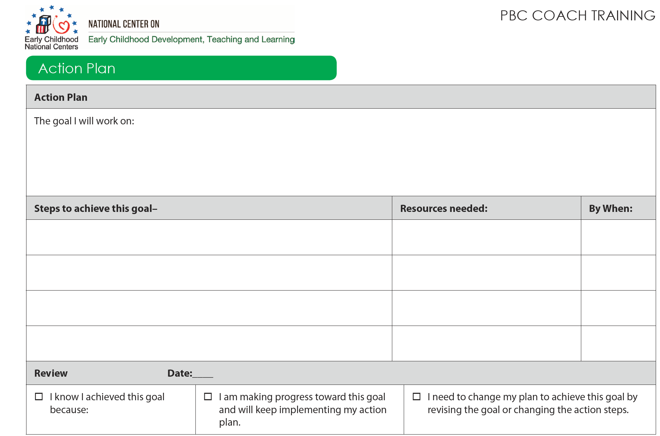

Slide 7
WHAT IS REFLECTION AND FEEDBACK?
Through reflection and feedback, changes in practice are considered, evaluated, and strengthened. In reflection and feedback, progress toward goals and action plan steps are discussed or considered, and new action steps or goals might be identified that become the focus of the next cycle of coaching. The coach guides a coachee’s reflection to encourage careful consideration of the implementation of new practices, the success of teaching efforts, and child responses to coachee implementation and early learning setting activities.
Notes:
Coaches also gain information about coachee and child interactions, a coachee’s strengths, and coachee perspectives. Both the coach and coachee have multiple opportunities to reflect and give feedback throughout the coaching partnership.

Slide 8
Coaching Contract

Slide 9
I, as the Coach, agree to:
____Support the teacher to assess his or her needs in effective instructional practices.
____ Develop an individual plan with the teacher that includes related to improving school readiness outcomes for all children. The plan will include steps for achieving goals and the coach’s and teacher’s responsibilities related to each step.
____ Schedule, plan, and facilitate onsite visits and coaching sessions.
____ Provide support in forms of sharing resources, providing models of effective practices, observing the teacher’s current practices, and supportive and constructive feedback.
____ Remain supportive rather than evaluative and maintain, however possible, a separation between coaching and performance evaluation.

Slide 10
I, as Teacher, agree to:
____ Actively engage in coaching sessions through assessing my strengths and needs, asking questions, sharing pertinent information, reflection, listening, and identifying goals and the means to achieve those goals in collaboration with the coach.
____ Be open to being observed and receiving feedback.
____ Apply and analyze new teaching practices with support of my coach.

Slide 15
THANK YOU

